Slide 1
Decoding Album Reviews for Pink Floyd’s Dark Side of the Moon:
Sentiment Analysis using NLP
By Nicholas Bronson

Slide 2
Agenda
1
2
Objectives
Methodology
3
4
Results
Recommendations
& Next Steps

Slide 3
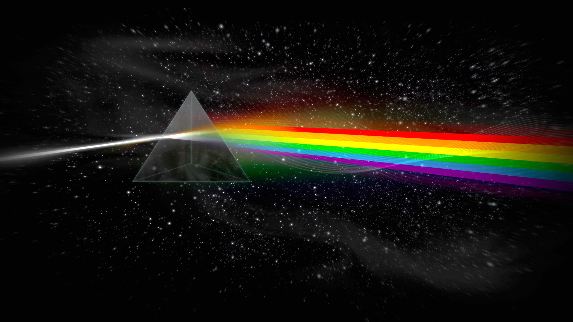

Objectives:
My client is a record label that is seeking to analyze text data that they have acquired regarding artists on their label and their peers.
They aim to conduct a larger scale analytics initiative, however, they wish to better understand how large text-based datasets can be analyzed.
Key Questions:
Can text data be used to categorize and interpret album reviewer sentiments?
What are listener sentiments on Pink Floyd’s Dark Side of the Moon, what are the perceived strengths and weaknesses of the album?

Slide 4



Methodology:
1547 Reviews
Average of 138 words per review
1494 reviews contain a rating (1-5)
Average Rating is ~4.4
Examination of classification methods including: Logistic Regression, Random Forest, Gradient Boosting
NMF is the primarily tool used
Data
Exploration
Pre -
Processing
Topic
Modeling
Pre -
Processing
Round 2
Topic
Modeling
Round 2
Supervised Learning
Conclusions, Outline of
Next Steps
Dimensionality
Reduction
Removal of punctuation, upper case letters
Tokenization
Addition of stop words in English and Spanish
Lemmatization
Notes:
Data Exploration → Pre-Processing → Dimensionality Reduction → Topic Modelin

Slide 5

Findings - Topic Modeling
I chose 8 topics the four of the most salient were as follows:
Extremely lengthy, highly positive and analytical reviews
Non-English reviews (Italian, Spanish, and Portuguese reviews were identified)
Short reviews labeling the album a “classic” or the “greatest album of all time”
Reviews noting the album is too overrated, or perhaps good but overrated
Notes:
Topics were not apparent from topic word lists, however, looking at individual reviews provided more insight

Slide 6
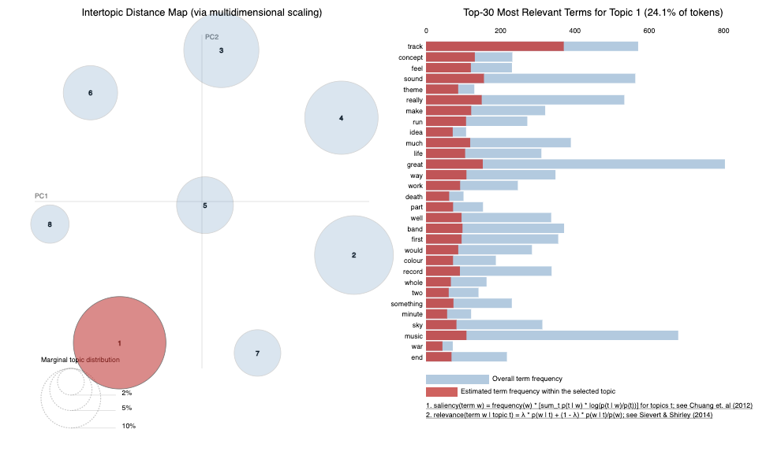
Topic Modeling - LDA Visualization

Slide 7
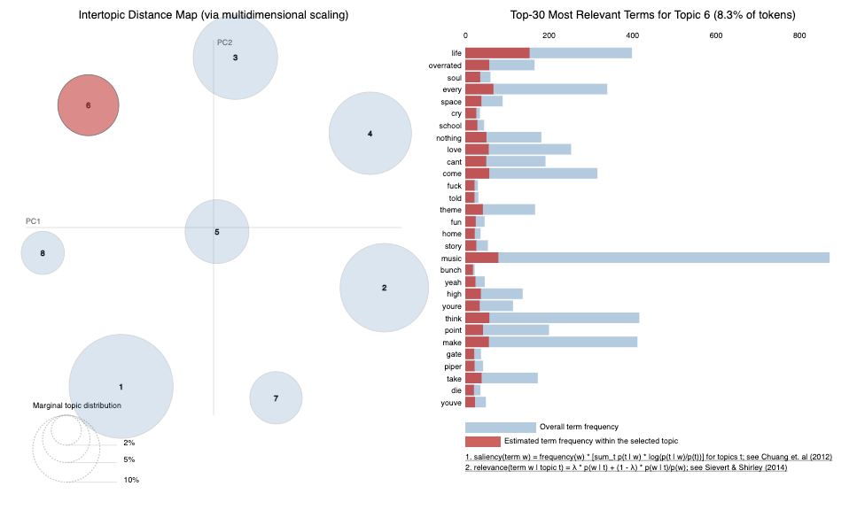
Topic Modeling - LDA Visualization

Slide 8
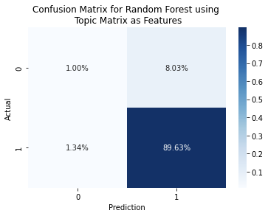
Classification - Random Forest
A random forest was able to provide the most nuanced results, other models were having difficulty predicting true negatives
This dataset is extremely unbalanced, with largely favorable reviews
This model suffers from the same issue, however, it shows promise as far as its ability to capture some of the true negatives
Accuracy: 0.904
Recall: 0.975
Precision: 0.923
F1: 0.948
Notes:
This model would be useful in exploring a set of data without ratings attached to it, perhaps the comments section of a RollingStone article

Slide 9
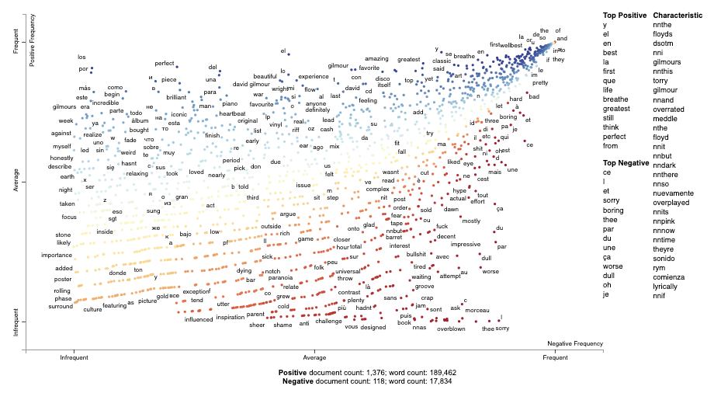
Scatter Text - Sentiment Analysis

Slide 10

Conclusions
Dark side of the moon is widely regarded as one of the “greatest” albums by reviewers
There is speculation that the album is “overrated”
The “guitar”, “bass”, and “piano” were mentioned frequently in reviews, seemingly well-regarded
The reviews were rather homogeneous
Notes:
Guitar, bass, and piano sounds were valued, talked about. Solo sections appear to be mentioned frequently
A more sound approach would be looking at a larger set of positively reviewed, medium level, and negatively reviewed albums and determining

Slide 11
Recommendations & Next Steps
Gather more data - this will allow clearer topics to emerge
Analyzing full-bodies of work of multiple artists within a single genre
Utilize CorEx to hone in on specific topics
Use of genre data
Perhaps construction of a content-based recommendation system
Notes:
Gather data across artists, analyze a large number of reviews in a single genre simultaneously
Metacritic

Slide 12

Thank you!

